Slide 1
Collections and Array Optimization
CSCI 2010U - Data Structures

Slide 2
Outline
Multidimensional Arrays
Collections
ArrayList
List
Array Optimization
Arrays
2

Slide 3
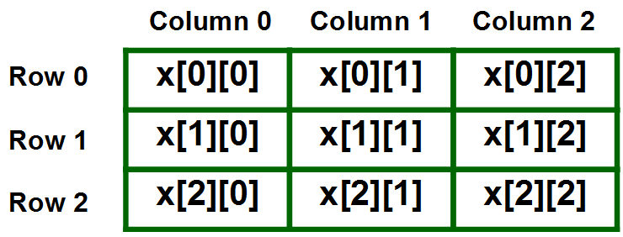
Multidimensional Array
A multidimensional array is an array of arrays.
https://www.geeksforgeeks.org/multidimensional-arrays-in-java/
4

Slide 4

Multidimensional Array
To create a two-dimensional array, add each array within its own set of curly braces:
https://www.w3schools.com/java/java_arrays_multi.asp
4

Slide 5
Collections in Java
A Collection is a group of individual objects represented as a single unit. Java provides Collection Framework which defines several classes and interfaces to represent a group of objects as a single unit
This framework consists of the List Interface as well as the ArrayList class
Arrays
5

Slide 6

ArrayList
Arrays are nice, but they have some serious limitations of size. Once size is assigned, it cannot be modified
One of the most versatile of Java’s collection classes is the ArrayList
In ArrayList, the size of an array is automatically taken care of.
Arrays
6
Notes:
The actual search time will vary for different lists and values to find. We could find the element at the start (examining just 1 element), or at the end (examining all n elements). How many elements will we examine on average?

Slide 7
ArrrayList vs. List
List | ArrayList
List is an interface | ArrayList is a class
List cannot be instantiated. | ArrayList can be instantiated.
List interface is used to create a list of elements(objects) that are associated with their index numbers. | ArrayList class is used to create a dynamic array that contains objects.
List interface creates a collection of elements that are stored in a sequence and they are identified and accessed using the index. | ArrayList creates an array of objects where the array can grow dynamically.
Arrays
7

Slide 8
Array Optimization
It is important to optimize the runtime and space in programming.
A good program is the one which uses less time and space.
In order to measure runtime and space complexity, we use Big-Oh
Arrays
8

Slide 9
Wrap-up
Multidimensional Arrays
Collections
ArrayList
List
Array Optimization
Arrays
9

